Slide 2
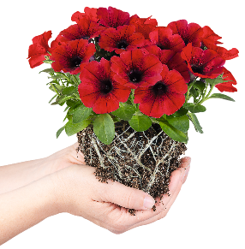
TRUE BEAUTY COMES FROM WITHIN
Stronger, healthier plants:
thanks to advanced breeding technology
Sustainable approach:
fewer chemicals, no fuss or worries, longer life cycle
Economic success:
less waste and fewer risks, for efficient results

Slide 3

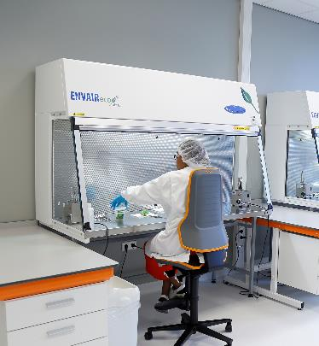
HOW IT WORKS
THE KEY IS TO UNDERSTAND THE KEY.
HOW IT WORKS
There is no better teacher than nature. By deciphering and analyzing the genetic code of plants, we learn about the precise biological causes for existing or missing resistances.
In the next step, INTRINSA™ carefully upgrades the DNA, systematically improving and extending crucial traits of a plant.
In this way, deficiencies are corrected from within, making use of the plant’s intrinsic capabilities.
The result: plants which are indifferent to various kinds of stress. 50 years after Woodstock, this is a great new era of flower power!

Slide 4

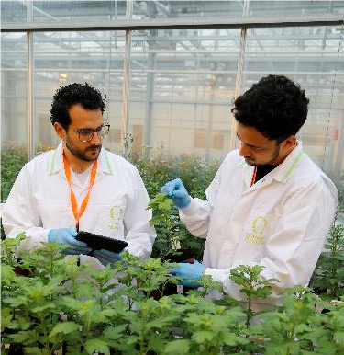
WHAT IT DOES FOR PLANTS
FOR HEALTHY PLANTS, THE SKY IS THE LIMIT.
No matter how much pressure external conditions put on a plant, they will have a hard time succeeding.
INTRINSA™ offers resistance against physical influences (heat, cold and drought) and against biotic factors (certain bacteria, fungi, viruses and insects).
This way, the natural beauty of your best-loved species is free to unfold. They get the green light to thrive in peace, enjoy a perfect life cycle and charm everyone with their sight and smell.
INTRINSA™ will give you value for money.

Slide 5

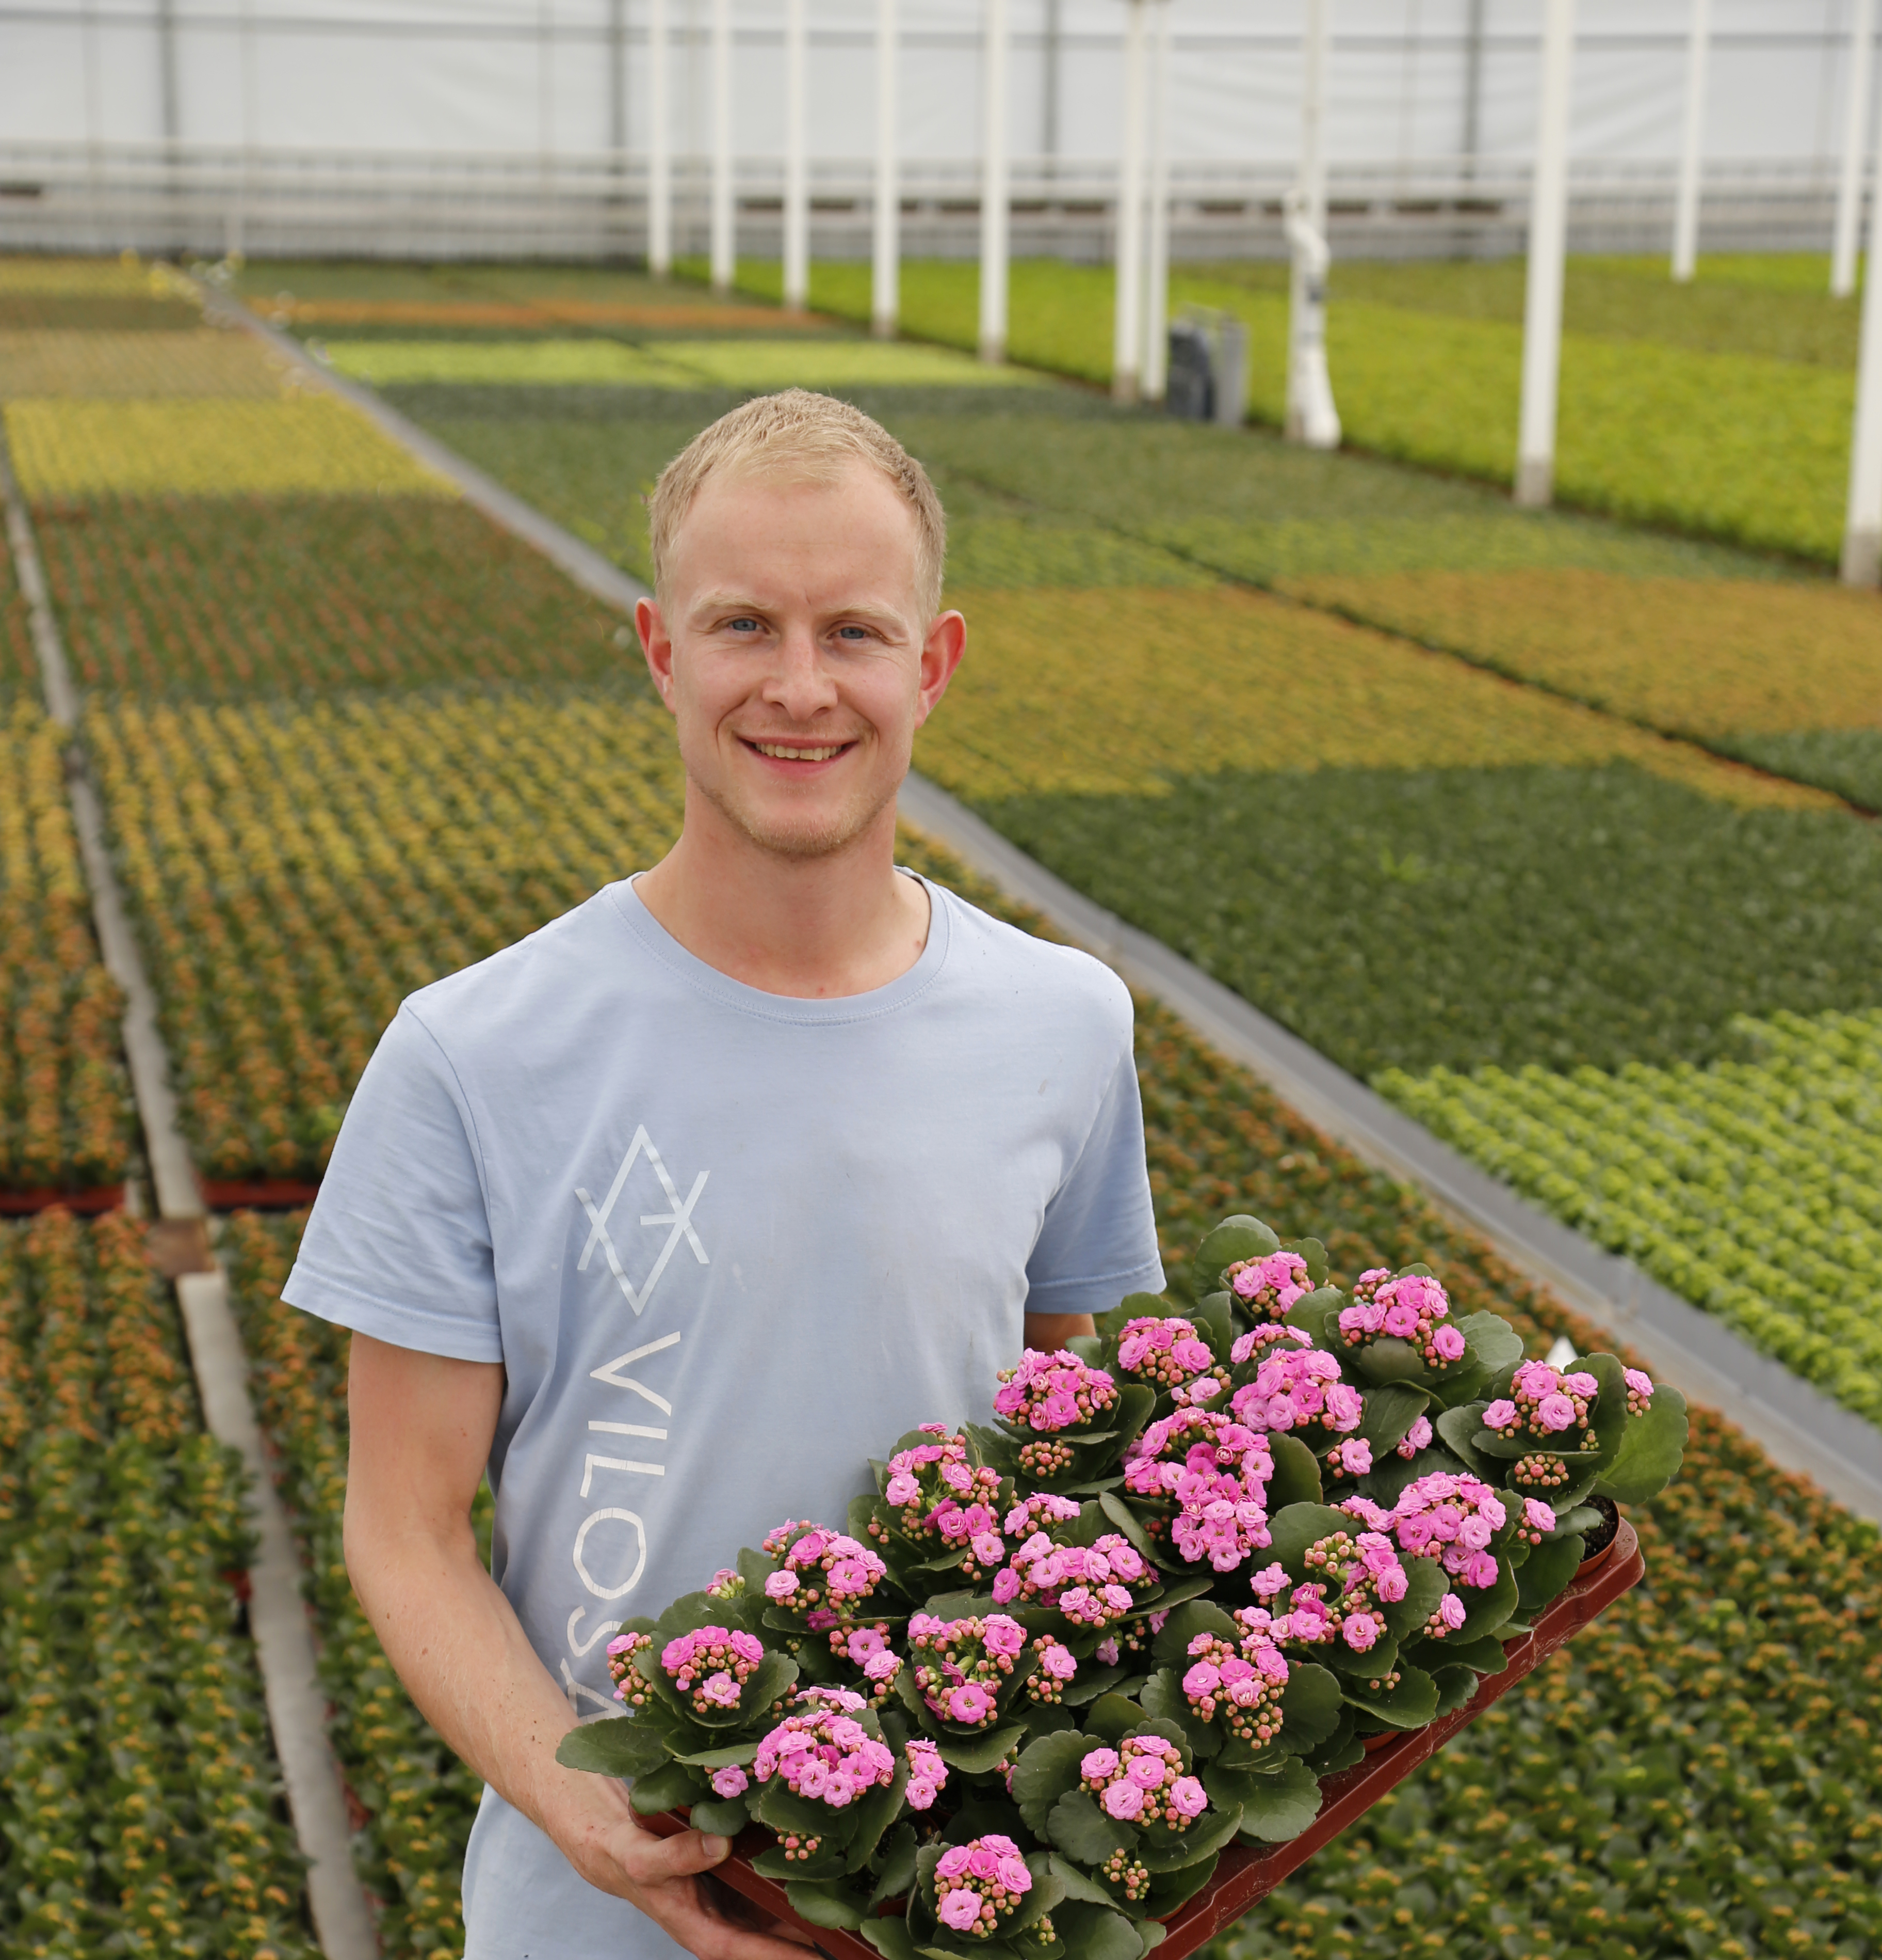
WHAT IT DOES FOR GROWERS AND RETAILERS
IT IS NOT ONLY A BONSAI THAT CAN GIVE
YOU PEACE OF MIND.
How much time, money and other resources have you invested in your professional life, simply trying to permanently keep all kinds of possible dangers away from your plants?
INTRINSA™ helps you relax – by strengthening plants from within.
INTRINSA™ contributes to a sustainable world: specific health, environmental or PR concerns resulting from the use of chemical methods now belong to the past.
Time to lean back and let your plants do the work for you. In other words: with INTRINSA™, you can care more by caring less.

Slide 6
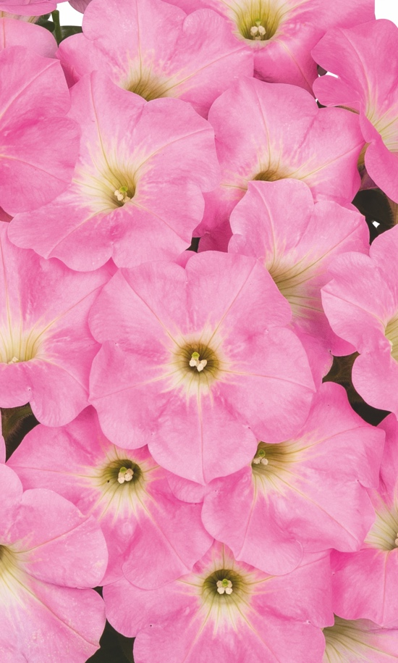
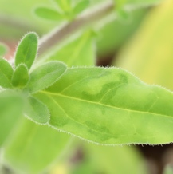
EXAMPLES
INTRINSA™ CHANGES THE GAME: AND THE WINNER IS ...
Example 1
Petunia vs TMV:
more security, less worries and better performance

Slide 7
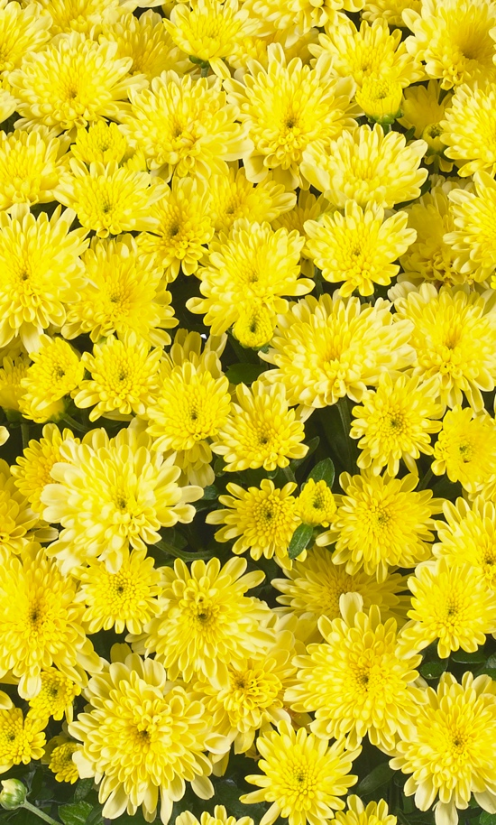
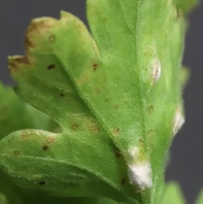
EXAMPLES
INTRINSA™ CHANGES THE GAME: AND THE WINNER IS ...
Example 2
Chrysanthemum vs White rust:
up to 100% fewer infections

Slide 8
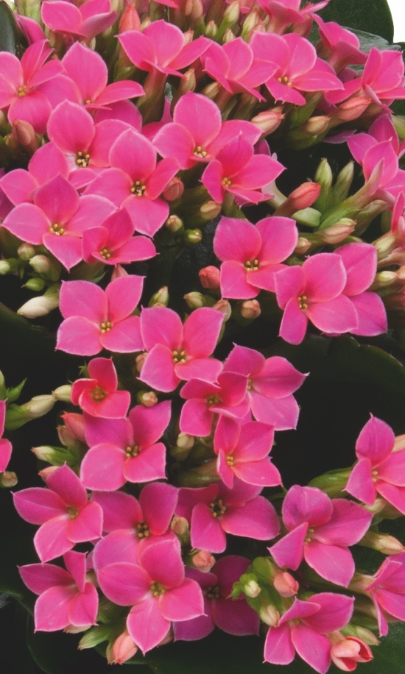
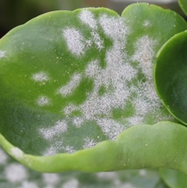
EXAMPLES
INTRINSA™ CHANGES THE GAME: AND THE WINNER IS ...
Example 3
Kalanchoe vs Powdery mildew:
putting an end to disfigurements

Slide 9


ABOUT DÜMMEN ORANGE
AS THE WORLD’S LARGEST PLANT BREEDER, WE KNOW A THING OR TWO ABOUT GROWTH.
Since its foundation in the year 2010 in the Netherlands, Dümmen Orange has successfully strived to offer exceptional premium plants – combining deep technological know-how with the ambition to be faster and more inventive than competitors.
Because our roots are not only Dutch, but also German, American and Japanese, an international perspective on plants comes naturally to us.
Our passion and determination have blossomed and borne fruit in a dynamic, yet sustainable way.
Today, we are the world market leader in the plant breeding industry.

Slide 10
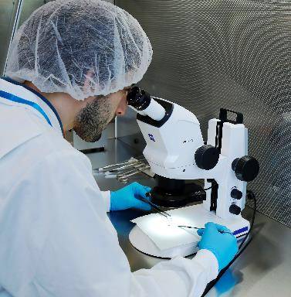
CONTACT
SMART FLOWERS TURN TO THE SUN,
SMART ENTREPRENEURS TURN TO US.
Part of our job is to make your life easier, and thus not to bother you too much with the scientific details. But if you would like to know everything about our patented INTRINSA™ technology, we will be glad to give you in-depth information and answer all your questions. Please feel free to contact us the way that best suits you!
By phone:
+31 (0)123 4567890
By email:
intrinsa@dummenorange.com
Via Facebook:
DummenOrange_EU or DummenOrange_NA

Slide 11

TRUE BEAUTY COMES FROM WITHIN

