Slide 2

THE FUTURE OF
BREEDING IS NOW
AIPH annual congress Beijing, China
Presenter Name

Slide 3
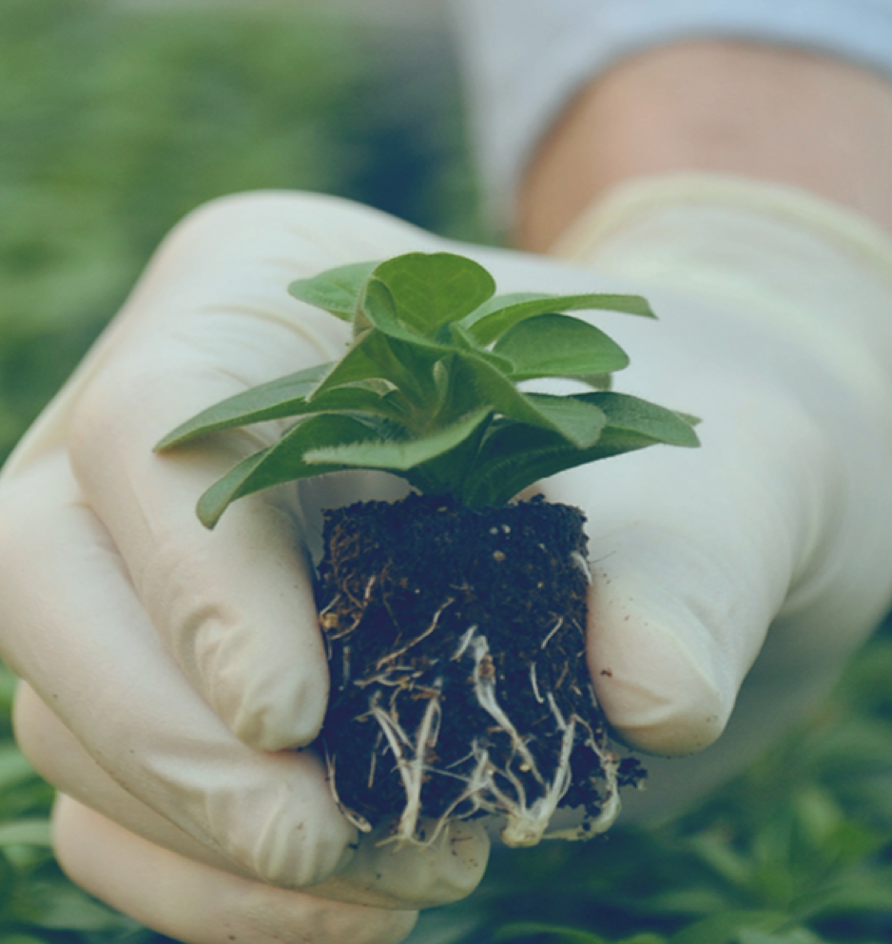
OUTLINE
THE FUTURE OF
BREEDING IS NOW
About Dümmen Orange
How we invest in our
customers’ success
Towards 2030
AIPH annual congress Beijing, China
Biense visser
| 3

Slide 4


ABOUT DÜMMEN ORANGE
Global #1
Focus on top 10 crops
Grow revenue to accelerate innovation
Ambition: >25%
market share
Global sales network
In direct contact with growers and retailers
Investing in customer intimacy
Investing in partnerships
AS LEADING FLORICULTURAL
BREEDER, WE CREATE
SUSTAINABLE VALUE
THROUGH DEEP CUSTOMER
UNDERSTANDING AND
INNOVATIVE PRODUCTS
Product
differentiation focus
Realizing
economies of scale
Outstanding services with staff plus digital tools
Integrated Pest Management
Active global CSR program
Caring of carbon footprint
Frontrunner new breeding, rooting and growing technologies
Intellectual
Property
| 4

Slide 5
DÜMMEN ORANGE AT A GLANCE
7.300
EMPLOYEES
190
R&D
PROFESSIONALS
20
PRODUCTION
LOCATIONS
330+
HECTARES OF
PRODUCTION
1.000+
IP TITLES
& BRANDS
3.000+
PATENTS
2.0bn+
CUTTINGS
PER YEAR
11.000+
CUSTOMERS
€350m
SALES
| 5

Slide 6
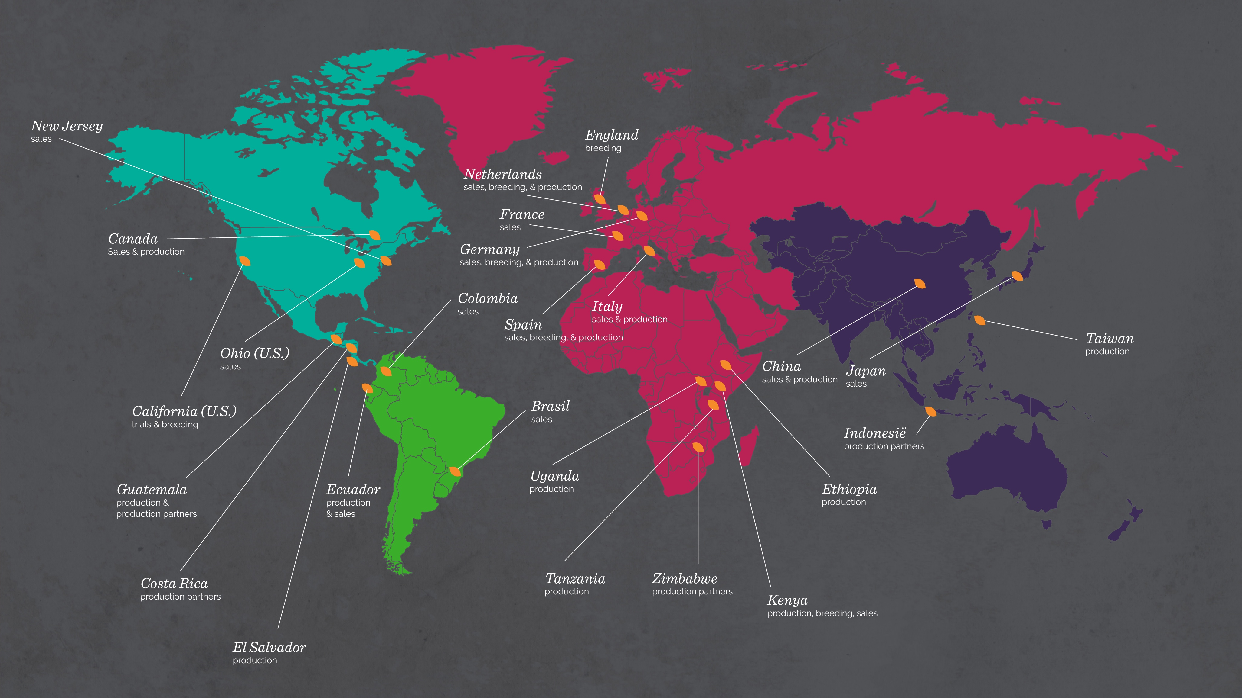

Slide 7

Strategic focus on scale & innovation
GROWING OUR BUSINESS
HIGHLY QUALIFIED STAFF
DIVERSIFIED MARKET WITH MANY OPPORTUNITIES
ABUNDANT M&A OPPORTUNITIES
INDUSTRY TRANSFORMING LIKE VEGETABLES INDUSTRY
HIGH AND INCREASING BARRIERS TO ENTRY
| 7

Slide 8
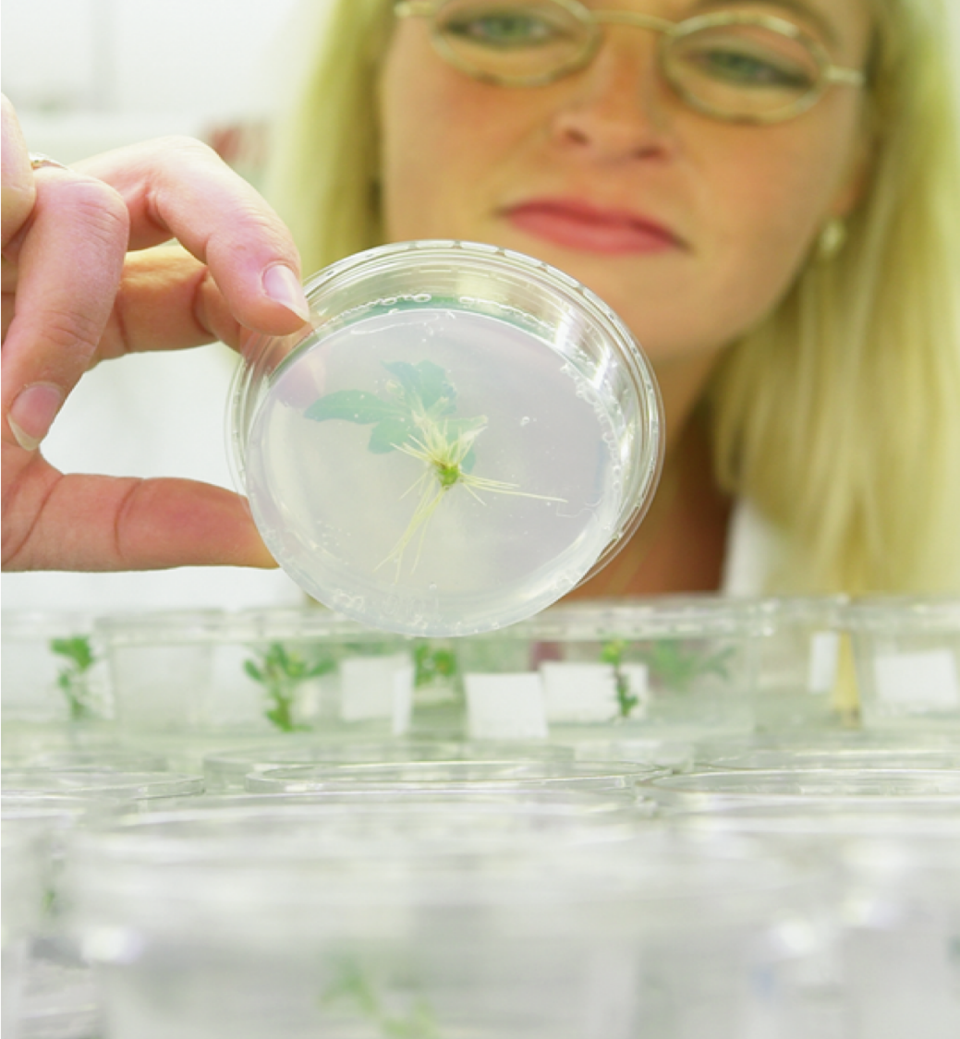
LEADING
THE TRANSITION
FIELD CROP AND
VEGETABLE SEED MARKET
FLOWER BREEDING
MARKET
€bn
€bn
+3X
+?X
3x value growth driven
partially by moving from traditional breeding to
trait and hybrid breeding
Dümmen Orange is leader in breeding, rooting and growing technologies
Shortening breeding cycle
Increasing faster market responsiveness
| 8

Slide 9
MEETING CUSTOMERS’ NEEDS THROUGH EXPANSION OF CROPS AND TECHNOLOGY
First flower breeder ever serving the global top 10 crops
| 9

Slide 10

INVESTING IN
OUR CUSTOMERS’
SUCCESS

Slide 11
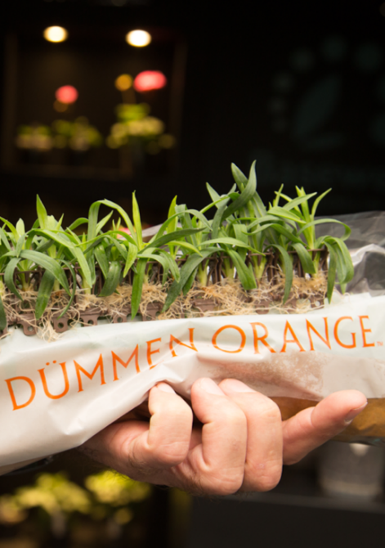

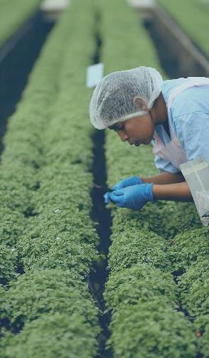
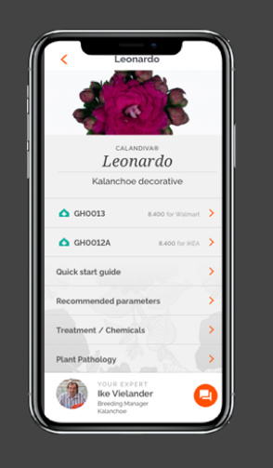

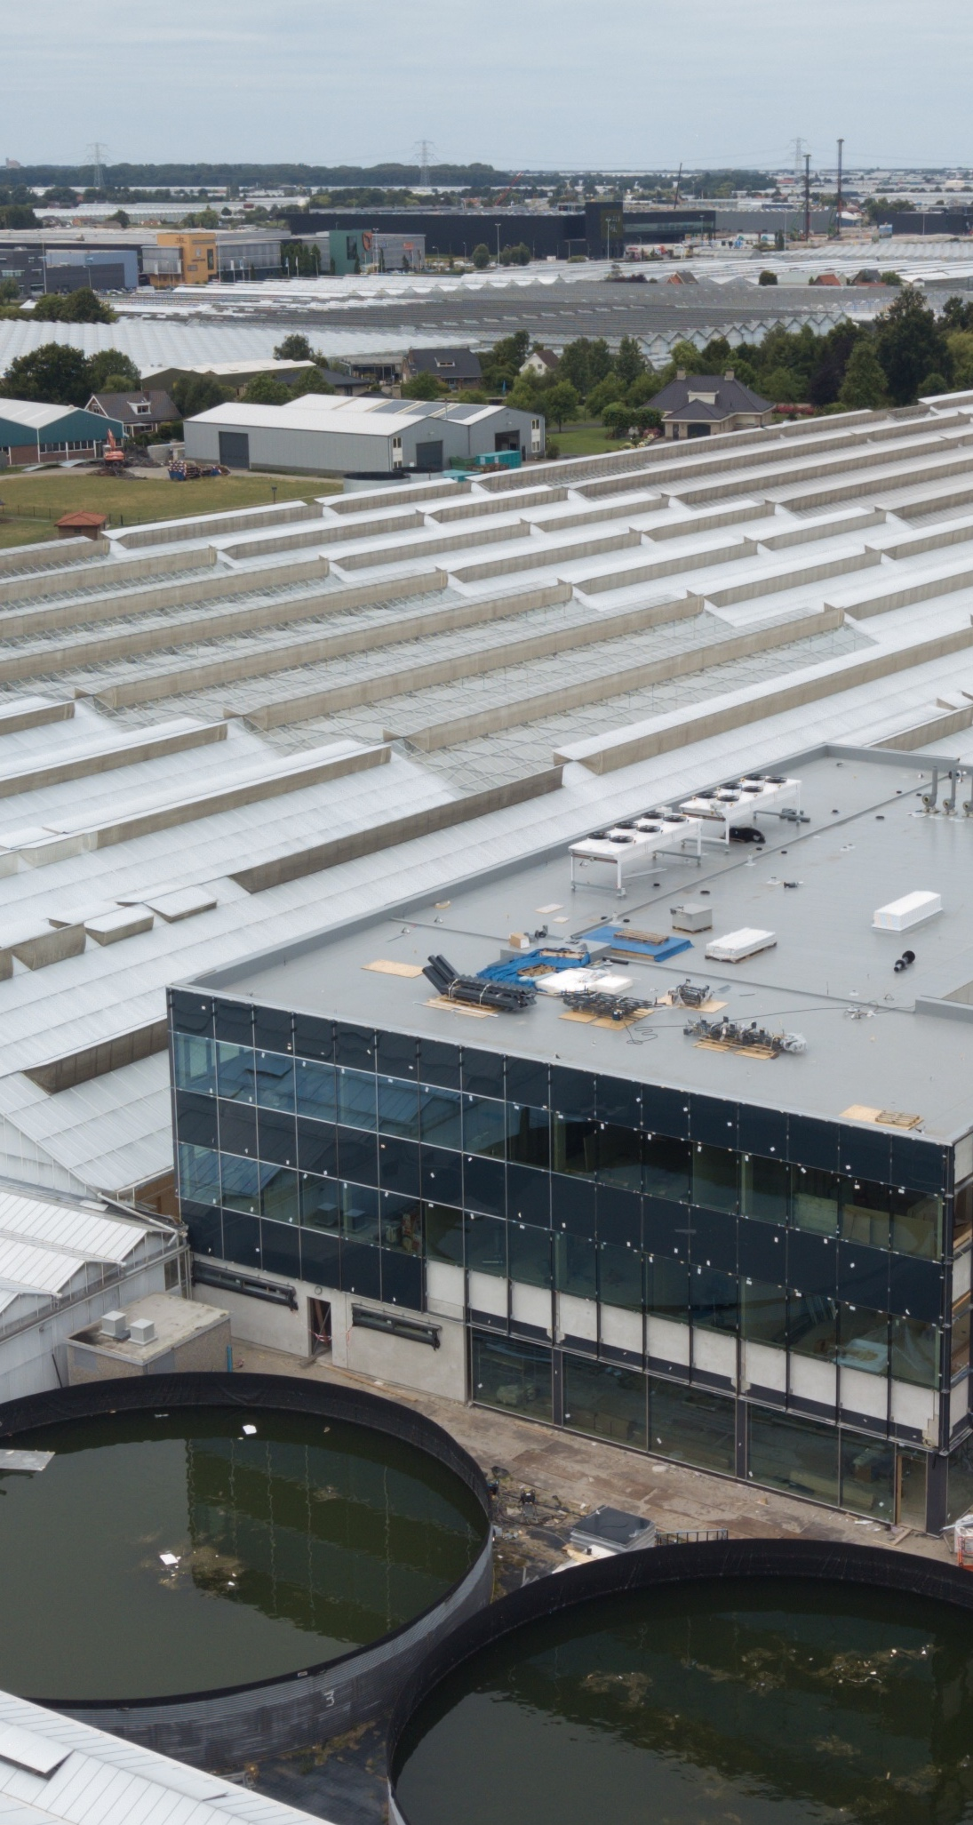


LEADING BY EXAMPLE
DIGITAL APPS
| 11

Slide 12
LEADING BY INNOVATION
PROBABILITY OF
SUCCES
→ From >100 traits,
31 active projects (focusing on top 12 crops with highest value)
Chrysanthemum
Thrips resistance
Chrysanthemum
Fusarium resistance
Rose
Botrytis resistance
Kalanchoe
Powdery mildew resistance
Future
Rose
Downy Mildew resistance
Active
Probability of Success
Tulip
TVX resistance
Chrysanthemum
TSWV resistance
NG impatiens
INSV resistance
Total royalty market
| 12

Slide 13

Minimal
Chemicals,
Maximum
Quality
3
SUPPLYING
THE WORLD
1
SUSTAINABLE
VISION
4
CREATING
GROWTH
2
GREENGUARD
METHOD
5
HAPPY
CONSUMER
| 13

Slide 14

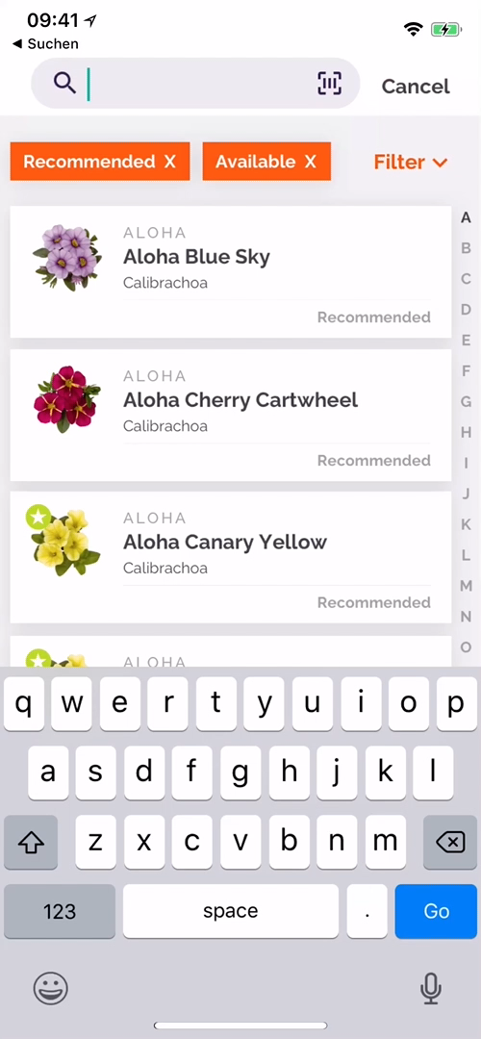
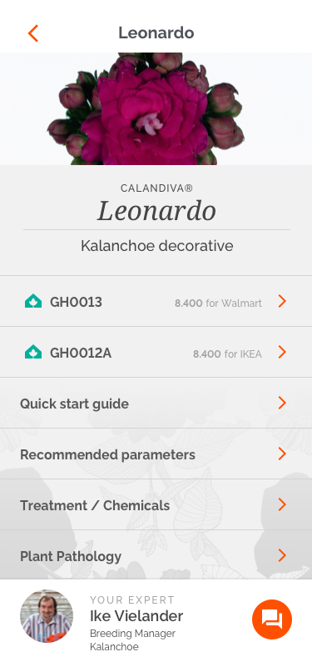
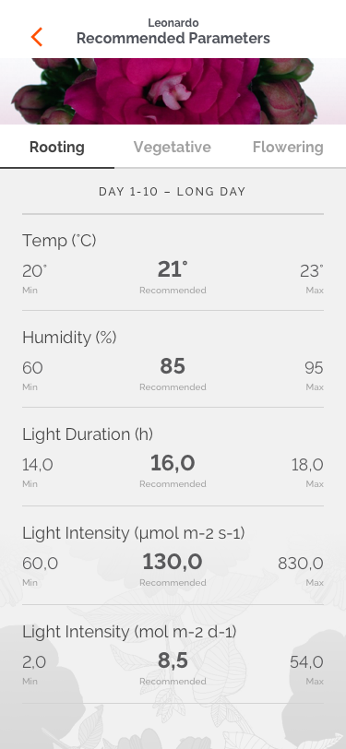
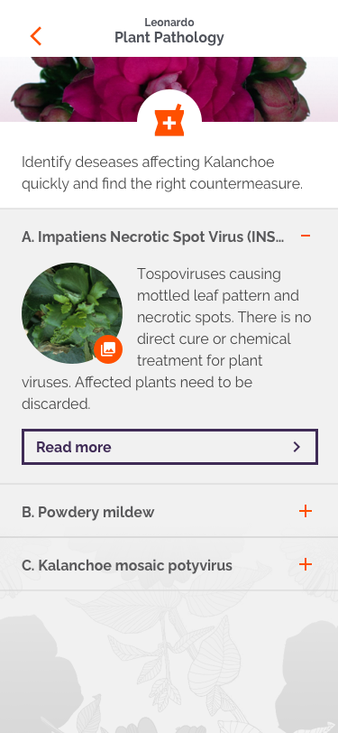
Digitizing customer Support
HELPING CUSTOMERS
TO GROW BETTER PRODUCTS
| 14

Slide 15

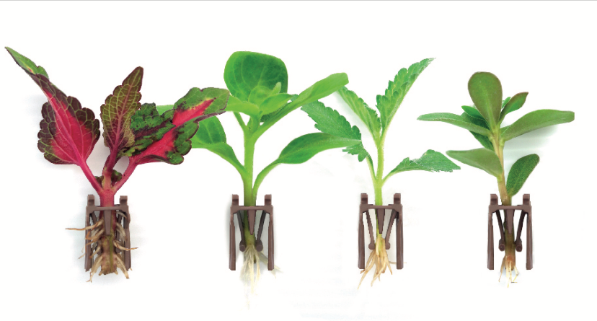

REDUCE COSTS AND COMPLEXITY
WITH GROUND BREAKING ROOTING TECHNOLOGY
Advanced root development with no growing media
Ships directly from off-shore rooting locations
Ready to transplant directly into finish containers
Biodegradable cartridges
Now available for wide range of Annuals and Perennials (Impatience, Coleus, Dahlia, Osteospermum, Calibrachoa, Salvia, Phlox, Verbena, etc)
| 15

Slide 16

Dümmen Orange
TOWARDS
THE FUTURE

Slide 17



THE CONSUMER
IN 2030
FLOWERS AND PLANTS
IN 2030
THE GROWER
IN 2030
More urbanized (→ apartment plants, landscaping, vertical
farming)
More digital than ever
(→ online ordering, mass
automation, Internet of Things)
Wants robust plants, low
maintenance (→ foliage,
garden performance)
Sustainability hygiene factor for plants (full transparency)
Growing consumption in Asia
Breeders become
plant designers
Significantly higher yield, product performance,
robustness and consume less resources
Driven by fashion and consumer trends
Continues consolidation, a concentrated group of efficient growers provides 80% of the volumes
Operates automated:
high-efficient with zero waste, artificial intelligence-driven cultivation
Sells mainly via B2B digital platforms with big box retail as largest buyer
Large growers want direct access to breeder via digital tools
Produces chemical-reduced carbon-conscious
| 17

Slide 18
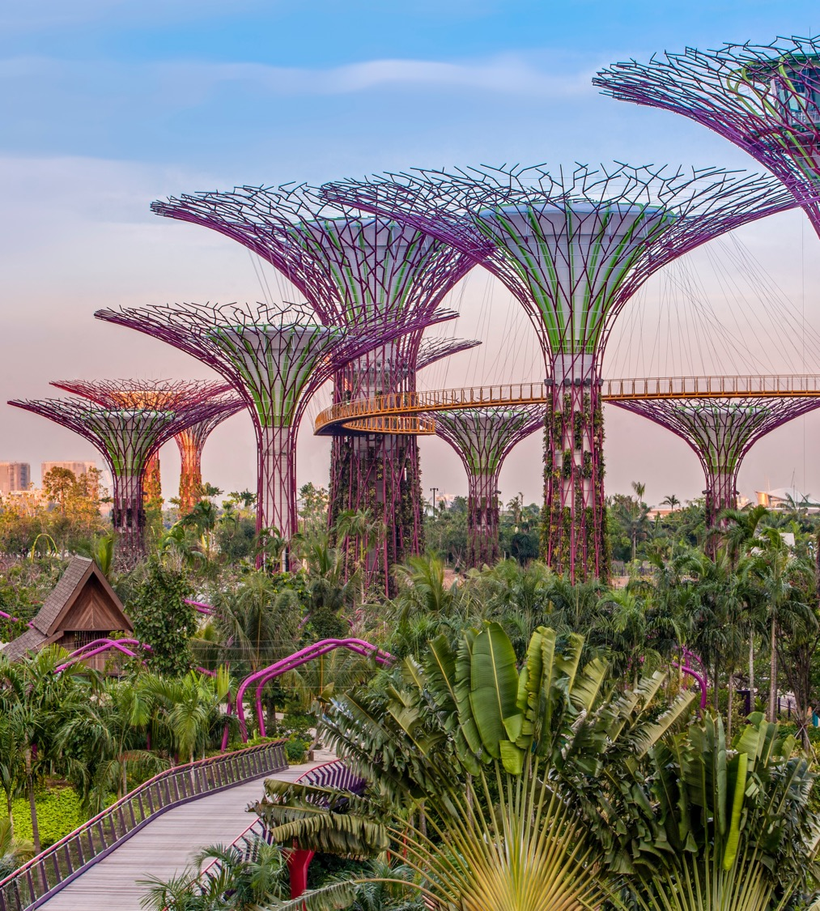
DÜMMEN ORANGE
IN 2030…
A well-known reliable breeder of a broad
and excellent product portfolio
Has a global sales network with dedicated partners, driving customer engagement and customer intimacy
Evolved into a floritech company with
growing license income
A leading digital enabled company
Preferred business partner for growers
and retailers
One of the top-2 floriculture companies
with >50% market share globally
| 18

Slide 20
FRONT + LAST NAME
JOB TITLE
YourName@DummenOrange.com

